Slide 1
COMBINATIONAL CIRCUITS
COMPUTER SYSTEM ARCHITECTURE
BY:
ROSHNI PATOA

Slide 2
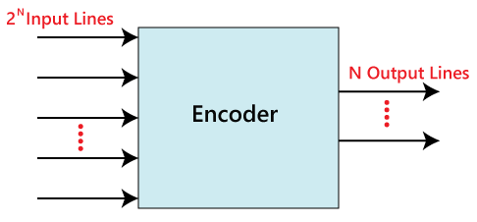
ENCODER
The combinational circuits that change the binary information into N output lines are known as Encoders. The binary information is passed in the form of 2N input lines. The output lines define the N-bit code for the binary information. In simple words, the Encoder performs the reverse operation of the Decoder. At a time, only one input line is activated for simplicity. The produced N-bit output code is equivalent to the binary information.

Slide 3
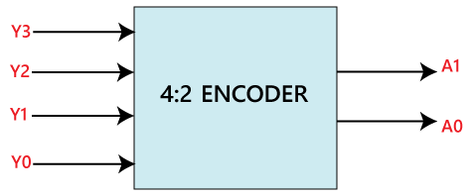
4X2 Encoder
In 4X2 encoder, there are total of four inputs, i.e., Y₀, Y₁, Y₂, and Y₃, and two outputs, i.e., A₀ and A₁. In 4-input lines, one input-line is set to true at a time to get the respective binary code in the output side. Below are the block diagram and the truth table of the 4 to 2 line encoder.

Slide 4
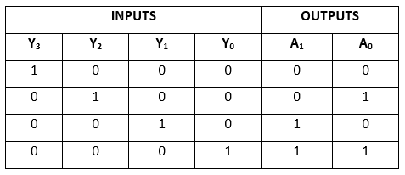
Truth Table for 4X2 Encoder
The logical expression of the term A0 and A1 is as follows:
A1=Y3+Y2 A0=Y3+Y1

Slide 5
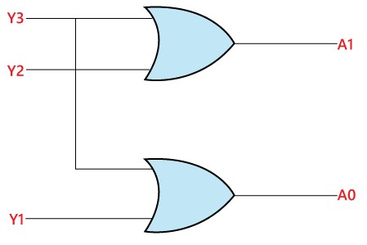
LOGIC DIAGRAM for 4X2 Encoder

Slide 6
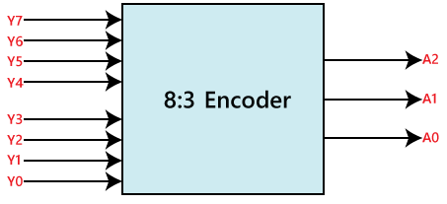
8x3 ENCODER
The 8x3 Encoder is also known as Octal to Binary Encoder. In 8x3 encoder, there is a total of eight inputs, i.e., Y₀, Y₁, Y₂, Y₃, Y₄, Y₅, Y₆, and Y₇ and three outputs, i.e., A₀, A1, and A₂. In 8-input lines, one input-line is set to true at a time to get the respective binary code in the output side. Below are the block diagram and the truth table of the 8x3 encoder.

Slide 7
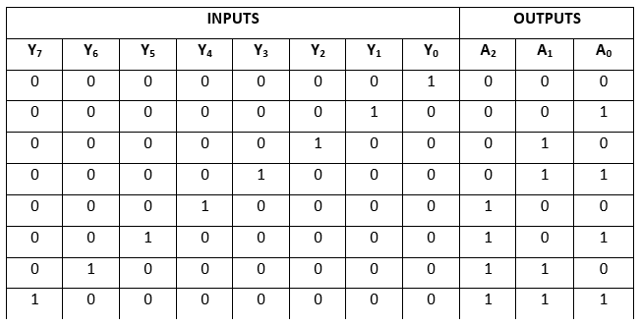
Truth Table for 8x3 ENCODER
The logical expression of the term A0, A1, and A2 are as follows:
A₂=Y₄+Y₅+Y₆+Y₇ A₁=Y₂+Y₃+Y₆+Y₇ A₀=Y₇+Y₅+Y₃+Y₁

Slide 8
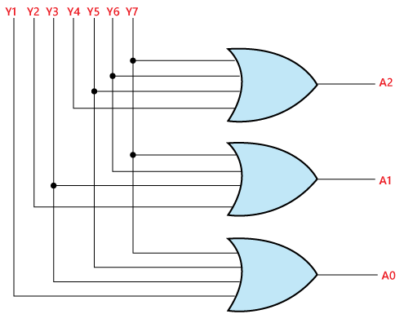
LOGIC DIAGRAM for 8x3 ENCODER

